Slide 1
INTRODUCTION TO ASSEMBLY LANGUAGE
Computer Organization and Assembly Language
Lec#12
Computer Science Department
National University of Modern Languages, Islamabad

Slide 2
USING REGISTERS
Registers are faster
Shorter instructions
  The number of registers is smaller (e.g. 32 registers need 5 bits)
Potential speedup
Minimize the frequency with which data is moved back and forth between the memory and processor registers.

Slide 3
ASSEBMLY LANGUAGE

Slide 4
MODES OF OPERATION
Real-Address mode (original mode provided by 8086)
  Only 1 MB of memory can be addressed, from 0 to FFFFF (hex)
  Programs can access any part of main memory
  MS-DOS runs in real-address mode
Protected mode (introduced with the 80386 processor)
  Each program can address a maximum of 4 GB of memory
  The operating system assigns memory to each running program
  Programs are prevented from accessing each other’s memory
  Native mode used by Windows NT, 2000, XP, and Linux
Virtual 8086 mode
  Processor runs in protected mode, and creates a virtual 8086 machine with 1 MB of address space for each running program

Slide 5
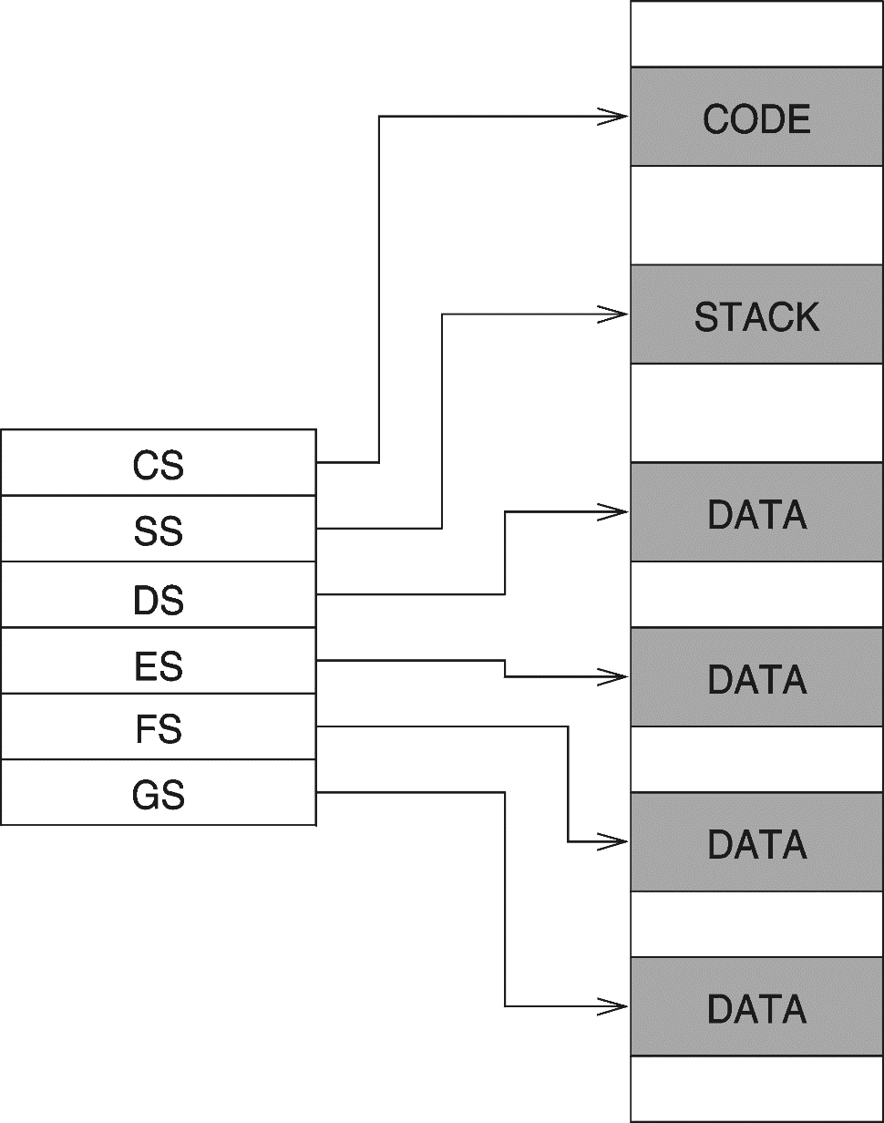
REAL ADDRESS MODE
A program can access up to six segments at any time
  Code segment
  Stack segment
  Data segment
  Extra segments (up to 3)
Each segment is 64 KB
Logical address
  Segment = 16 bits
  Offset = 16 bits
Linear (physical) address = 20 bits

Slide 6
FLAT MEMORY MODEL
Modern operating systems turn segmentation off
Each program uses one 32-bit linear address space
  Up to 2³² = 4 GB of memory can be addressed
  Segment registers are defined by the operating system
  All segments are mapped to the same linear address space
In assembly language, we use .MODEL flat directive
  To indicate the Flat memory model
A linear address is also called a virtual address
  Operating system maps virtual address onto physical addresses
  Using a technique called paging
Notes:
paging is a memory management scheme by which a computer stores and retrieves data from secondary storage for use in main memory. In this scheme, the operating system retrieves data from secondary storage in same-size blocks called pages.
Logical Address is generated by CPU while a program is running. The logical address is virtual address as it does not exist physically, therefore, it is also known as Virtual Address. This address is used as a reference to access the physical memory location by CPU.
Physical Address identifies a physical location of required data in a memory. The user never directly deals with the physical address but can access by its corresponding logical address

Slide 7
PROGRAMMER VIEW OF FLAT MEMORY
Same base address for all segments
  All segments are mapped to the same linear address space
EIP Register
  Points at next instruction
ESI and EDI Registers
  Contain data addresses
  Used also to index arrays
ESP and EBP Registers
  ESP points at top of stack
  EBP is used to address parameters and variables on the stack
Linear address space of a program (up to 4 GB)
32-bit address
ESI
DATA
EDI
32-bit address
CODE
EIP
32-bit address
STACK
EBP
ESP
Unused
CS
DS
SS
ES
base address = 0 for all segments

Slide 8
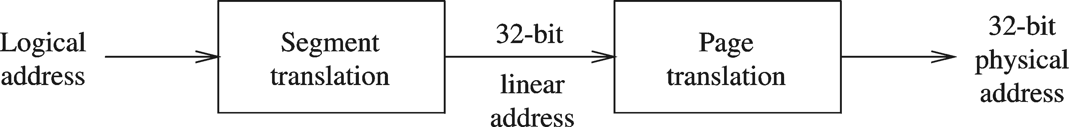
PROTECTED MODE ARCHITECTURE
Logical address consists of
  16-bit segment selector (CS, SS, DS, ES, FS, GS)
  32-bit offset (EIP, ESP, EBP, ESI ,EDI, EAX, EBX, ECX, EDX)
Segment unit translates logical address to linear address
  Using a segment descriptor table
  Linear address is 32 bits (called also a virtual address)
Paging unit translates linear address to physical address
  Using a page directory and a page table

Slide 9
SUMMARY-ADDRESSABLE MEMORY
Protected mode
  4 GB
  32-bit address
Real-address and Virtual-8086 modes
  1 MB space
  20-bit address

Slide 10
ASSEMBLY LANGUAGE PROGRAMMING
For Intel Systems
Software Required
  MASM
  Code View (Debugger)

Slide 11
FORMAT OF PROGRAM
Identifiers are case insensitive.
Comments follow ‘;’ character.
Sections: Data, Code, and Stack.
Hexadecimal Numbers have ‘h’ suffix.

Slide 12
BASICS
Directives vs. Instructions.
  Use Directives to tell assembler what to do.
  Use Instructions to tell CPU what to do.
Procedure defined by:
  [Name] PROC
  [Name] ENDP
Instruction Format:
  LABEL (optional), Mnemonic, Operands

Slide 13
DIRECTIVES
Commands that are recognized and acted upon by the assembler
  Not part of the Intel instruction set
  Used to declare code, data areas, select memory model, declare procedures, etc.
Different assemblers have different directives
  NASM != MASM, for example

Slide 14
INSTRUCTIONS
Assembled into machine code by assembler
Executed at runtime by the CPU
Member of the Intel IA-32 instruction set
Parts
  Label
  Mnemonic
  Operand
  Comment

Slide 15
I/O
Not as easy as you think, if you program it yourself.
We can use the library provided by the author of the textbook.
But we will do it ourself.

Slide 16
PROGRAM/DATA REPRESENTATIONS
Consider this simple view: The whole program is stored in main memory.
  Including program instructions (code) and data.
  CPU loads the instructions and data from memory for execution.

Slide 17
WHERE ARE THE DATA?
Registers (inside the CPU)
Memory
Constant

Slide 18
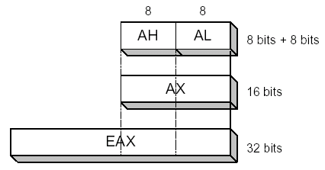
REGISTERS
General-Purpose:
  AX, BX, CX, DX: 16 bits
  Splitted into H and L parts, 8 bits each.
  Extended into E?X to become 32-bit register (i.e., EAX, EBX,…etc.).

Slide 19
CONVENTION
AX: accumulator
BX: base register
CX: count register
DX: data register
Some instructions use them implicitly. (e.g., LOOP uses CX with no mentioning.)

Slide 20
OTHER REGISTERS
Segment (CS, DS, SS, ES)
Pointer (IP, SP, BP)
Index (SI, DI)
Flags

Slide 21
CHARACTER STRING
So how are strings like “Hello, World!” are stored in memory?
ASCII Code! (or Unicode…etc.)
Each character is stored as a byte.
Review: how is “1234” stored in memory?

Slide 22
INTEGER
A byte can hold an integer number:
  between 0 and 255 (unsigned) or
  between –128 and 127 (2’s compliment)
How to store a bigger number?
Review: how is 1234 stored in memory?

Slide 23
DATA TRANSFER INSTRUCTIONS
MOV is for moving data between:
  Memory
  Register
  Immediate (constant)
Almost all combinations, except:
  Memory to Memory!

Slide 24
MOV INSTRUCTION
Move from source to destination. Syntax:
    MOV destination,source
No more than one memory operand permitted
CS, EIP, and IP cannot be the destination
No immediate to segment moves
.data
count BYTE 100
wVal WORD 2
.code
mov bl,count
mov ax,wVal
mov count,al
mov al,wVal ; error
mov ax,count ; error
mov eax,count ; error

Slide 25
YOUR TURN . . .
Explain why each of the following MOV statements are invalid:
.data
bVal BYTE 100
bVal2 BYTE ?
wVal WORD 2
dVal DWORD 5
.code
mov ds,45 ; a.
mov esi,wVal ; b.
mov eip,dVal ; c.
mov 25,bVal ; d.
mov bVal2,bVal ; e.

Slide 26
FOOD FOR THOUGHT
Example: MOV AX, 25
But, where is the number stored? In memory?
A related question: where is the instruction (MOV AX, 25) stored?
What do we do if we want to move the data in memory address 25 to AX?

Slide 27
MEMORY TO MEMORY?
Must go through a register…
.data
Var1 WORD 100h
Var2 WORD ?
.code
MOV AX, var1
MOV var2, AX

Slide 28
DIRECT MEMORY OPERANDS
A direct memory operand is a named reference to storage in memory
The named reference (label) is automatically dereferenced by the assembler
.data
var1 BYTE 10h
.code
mov al,var1 ; AL = 10h
mov al,[00010400] ; if var1 at offset 10400h
mov al,[var1] ; AL = 10h
alternate format

Slide 29
REFERENCE
Assembly language for Intel Base Cmputers
Kip R Irvine
  Chapter 2,3

